Slide 1
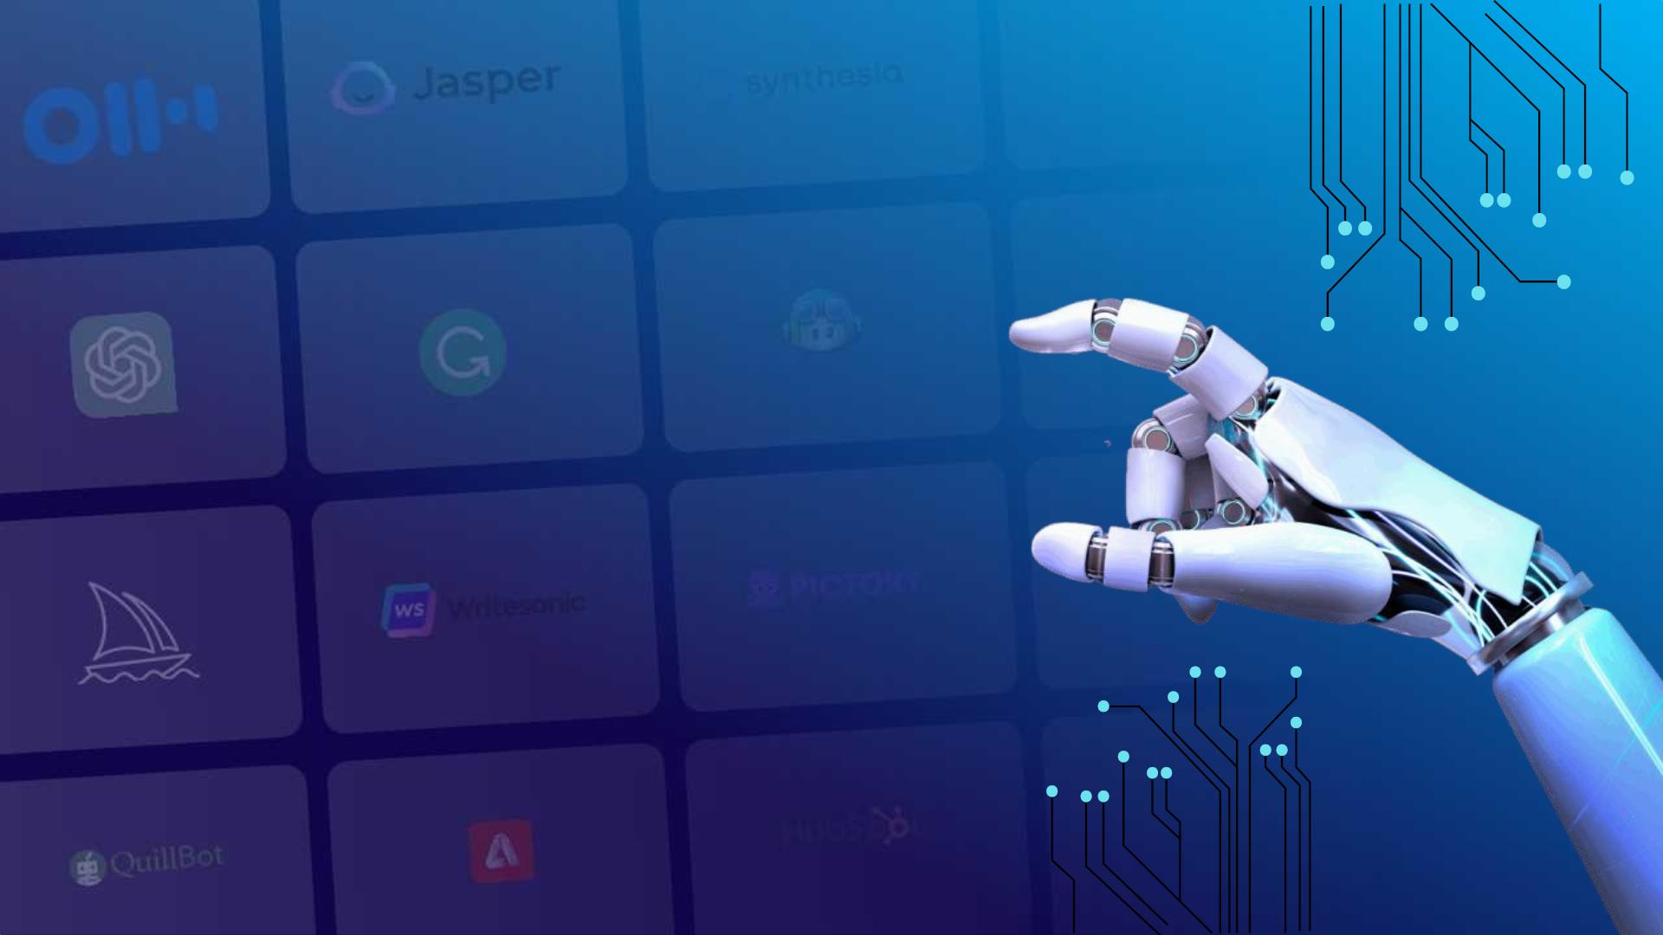
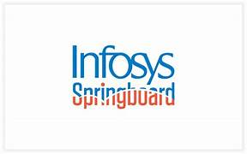
Smart Stock: Inventory Optimization for Retail Stores
AI-Based Retail Inventory Forecasting System
Presented by:
BHAKTHI S P
CHARISHMA
ARAVINDA
SAKSHI
Guided by:
SAKTHI GOPALAKRISHNAN
1

Slide 2


Problem Statement
Lack of Real-Time Inventory Visibility
Manual tracking and delayed updates cause stockouts, overstock, and no unified view of inventory.
Inaccurate Demand Prediction
Traditional methods struggle with large datasets like FreshRetail50K, leading to poor forecasts and inventory loss.
Operational Inefficiencies Across Multiple Stores
No automated alerts and slow data sync increase storage costs and reduce customer satisfaction.
2

Slide 3
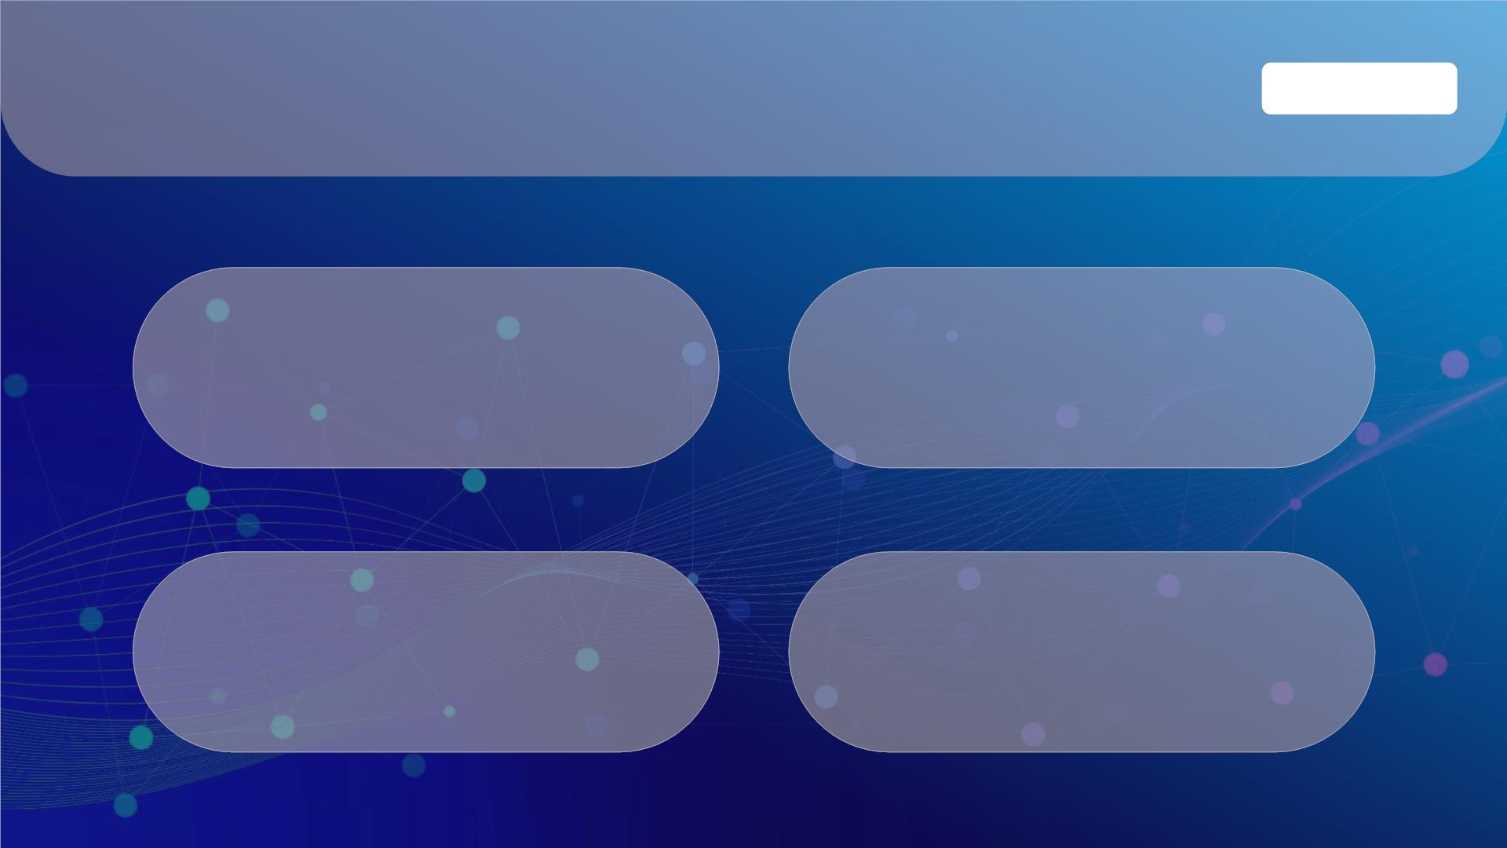
Core Objectives
AI Agent
Primary Objective
Machine Learning & Forecasting
To develop an inventory optimization system that predicts product demand and monitors stock in real time.
Implement GBoost-based sales forecasting.
Develop real-time inventory dashboard.
Backend Development & APIs
Deployment & User Management
Build Flask-powered REST APIs.
Integrate PostgreSQL cloud database.
Enable Admin and Store Manager authentication.
Deploy the system on Render cloud.
3

Slide 4
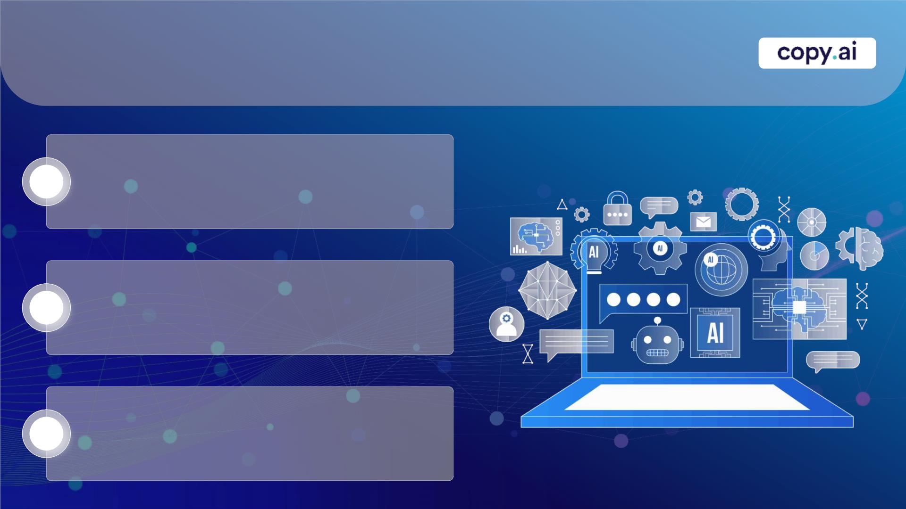
Dataset – FreshRetail50k
Large-Scale Retail Data:
Contains 50,000+ records of daily sales, stock, and store information across multiple cities.
1
2
3
Training Dataset:
• 18 Cities
• 736 Products
• 876 Stores
Time-Series Format:
Includes historical sales, stock levels, discounts, and holiday/activity flags for demand forecasting.
Challenges:
High volume and complexity make manual analysis difficult, requiring ML models like XGBoost for accurate predictions.
4

Slide 5
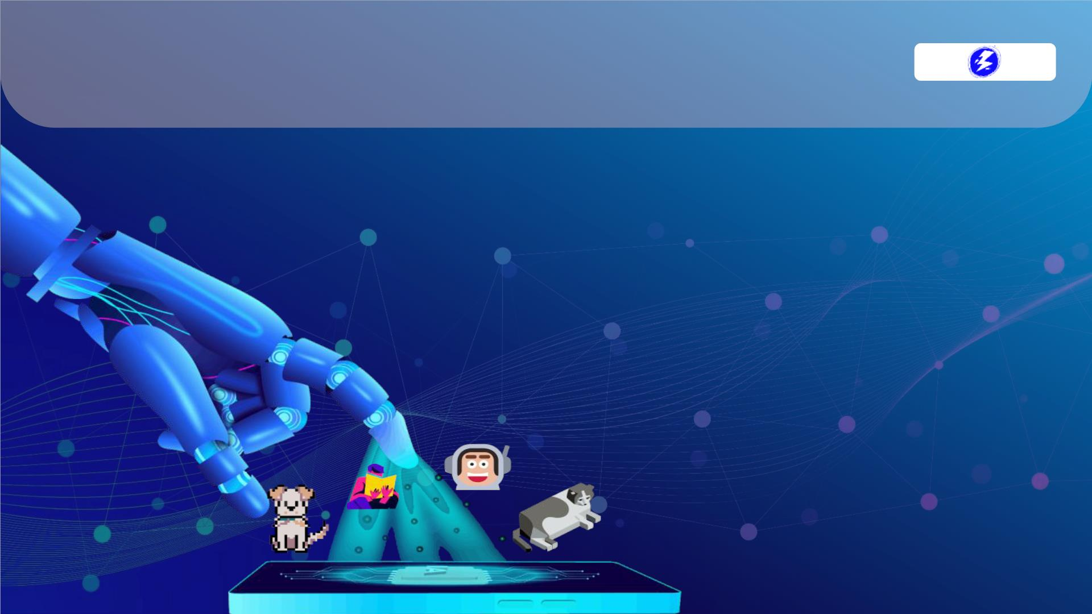
Key Features
• AI-based sales forecasting using XGBoost
• Real-time inventory tracking across stores
• Automated alerts for understock and overstock
• Role-based authentication for Admin & Managers
• Centralized PostgreSQL cloud database
• Interactive dashboard with stock & forecast insights

Slide 6
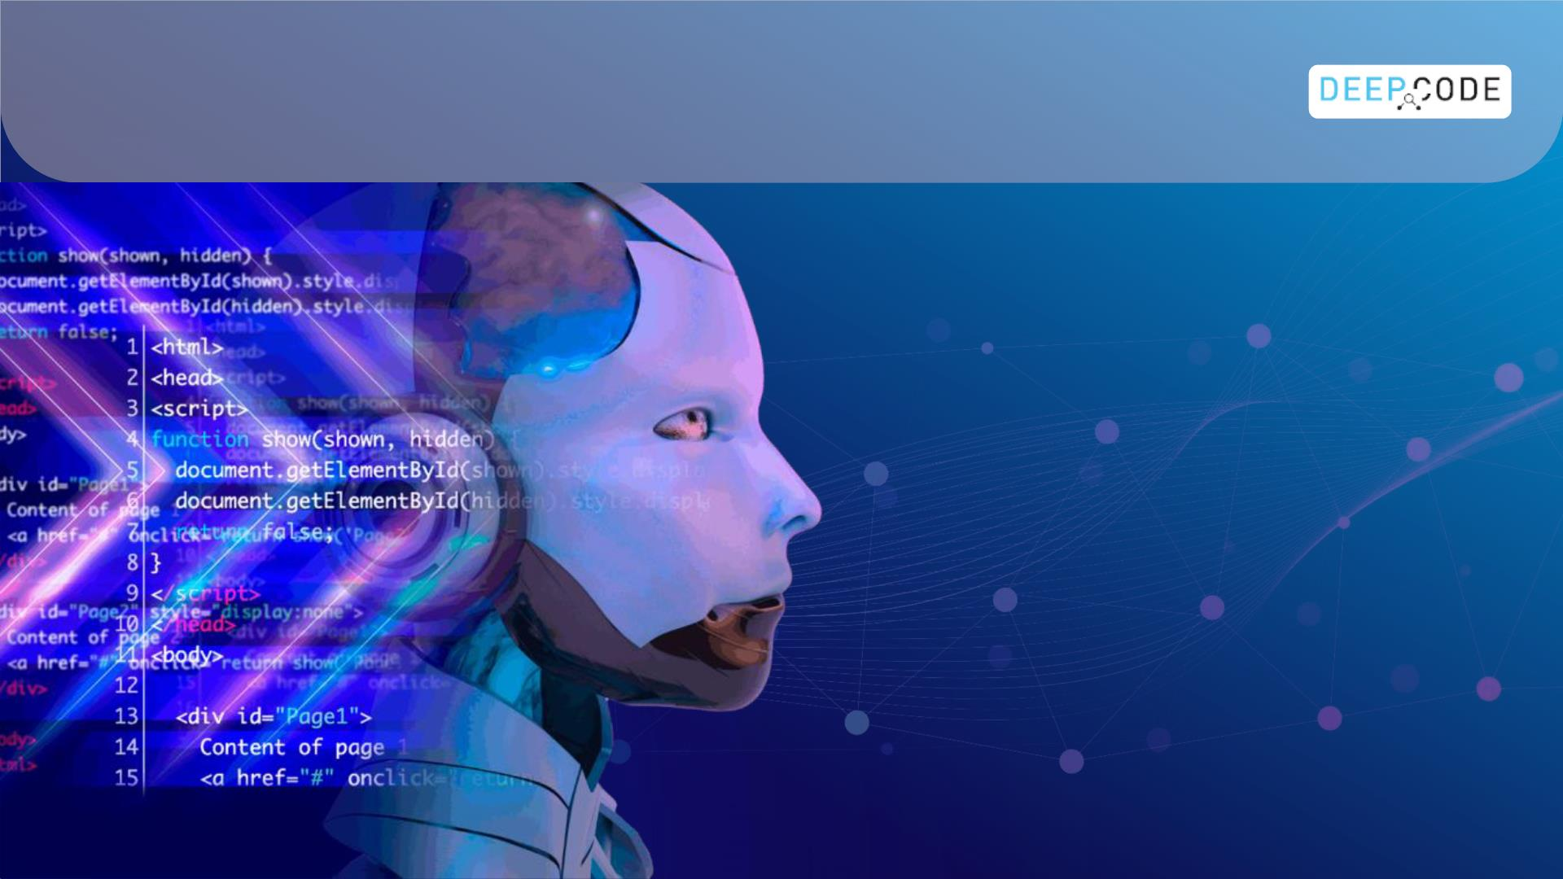
Tools and Technologies
Backend & Frameworks
Python
Flask
Flask-Login
REST APIs
Machine Learning
XGBoost
Pandas
NumPy
Database & Storage
PostgreSQL (Cloud)
MySQL (Local)
SQLAlchemy
psycopg2
Frontend
HTML
CSS
JavaScript
Bootstrap
Development &Deployment
Render Cloud
GitHub
VS Code
Postman
API & Data Handling
JSON
CSV Processing

Slide 7

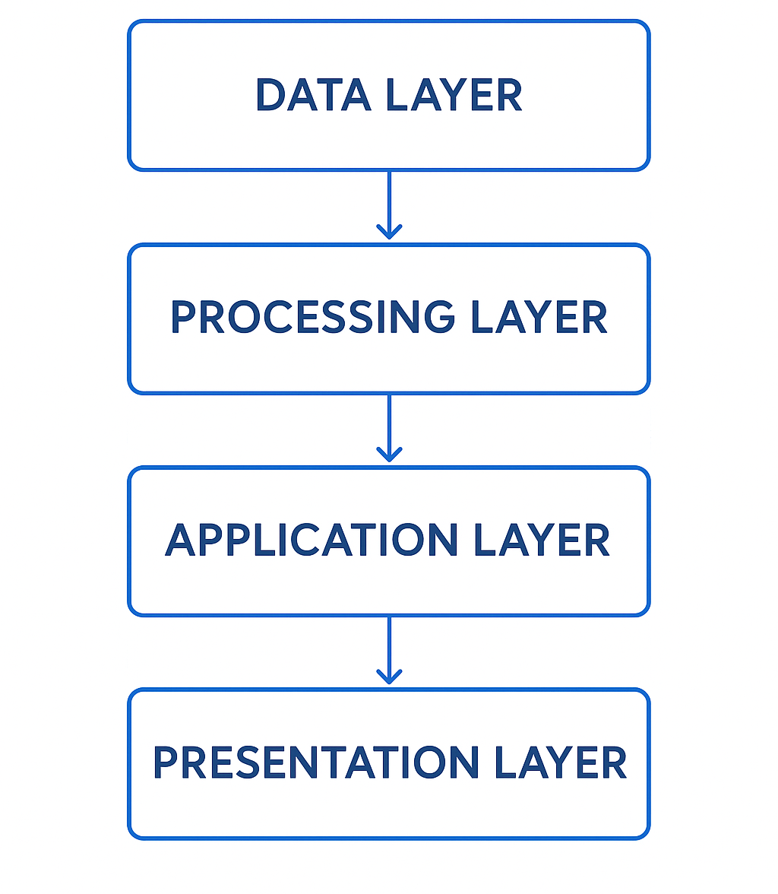
Layers of System
1️⃣ Data Layer
This is the foundation of our system. It includes all the raw data and storage:
FreshRetail50K Dataset → the large dataset with sales, stock, and store info.
PostgreSQL Cloud Database → stores structured data for queries and analysis.
2️⃣ Processing Layer
This is the “brain” of our system where data gets prepared for predictions. Includes:
Data preprocessing → cleaning and formatting the raw data.
Feature engineering → creating useful variables/features for the model.
XGBoost model training → training the ML model to forecast demand.
3️⃣ Application Layer
This is the backend / server logic connecting data and presentation. Includes:
Flask backend APIs → handle requests between frontend and backend.
Authentication module → manage Admin & Manager logins.
Forecast prediction engine → generates predictions using the trained model.
4️⃣ Presentation Layer
This is the user interface, what the user sees and interacts. Includes:
Web-based dashboard → displays sales, stock, alerts, and forecasts.
Inventory monitoring tables → track real-time stock across stores.

Slide 8
System Flow
User → Web UI:
The user interacts with a web-based dashboard to view inventory, sales, and forecasts.
Web UI → Flask API:
Requests from the UI are sent to the Flask backend API for processing and data retrieval.
Flask API → ML Model (XGBoost):
The backend passes relevant sales and stock data to the XGBoost model for 7-day demand forecasting.
ML Model → PostgreSQL Database:
Predictions and processed data are stored or updated in the cloud PostgreSQL database for centralized access.
PostgreSQL → Dashboard Output:
The dashboard fetches real-time data and displays stock status, alerts, and forecast insights to the user.
User
Web UI
Flask API
ML model
XG Boost
PostgreSQL
Database
Dashboard
Output

Slide 9
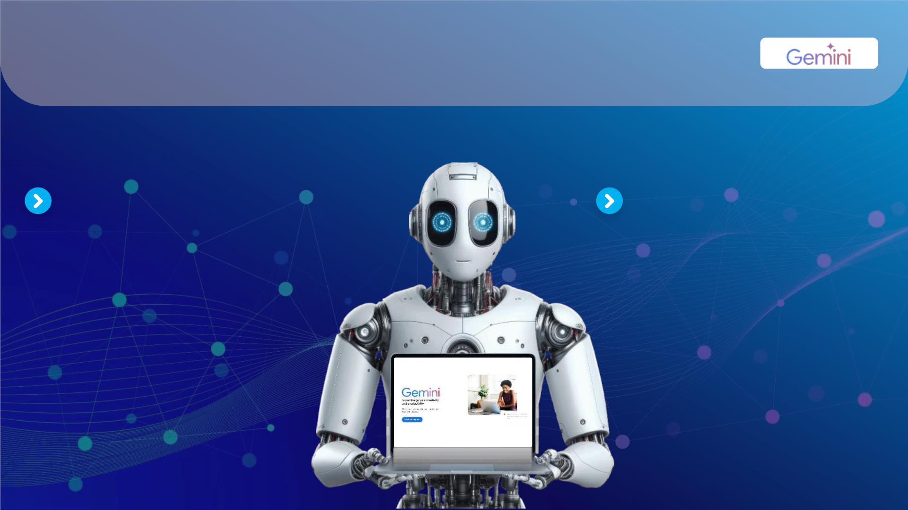
Implementation
BACKEND IMPLEMENTATION
  Framework Used: Flask (Python)
  Core Functionalities:
  • User Login Authentication
  • Inventory Data Retrieval
  • Forecast Prediction API
  • Stock Status Classification
  • Alert System Generation
  • PostgreSQL Integration
  Backend Workflow:
  Fetch data from database
  Run XGBoost predictions
  Compare stock vs forecast
  Generate status & alerts
  Send output to dashboard
FRONTEND DASHBOARD
  Dashboard Displays:
  • City • Sales
  • Available Stock • Store ID
  • Predicted Sales • Product ID
  • Stock Status • Date
  Frontend Technologies:
  • HTML – Structure
  • CSS – Light theme design
  • JavaScript – Dynamic updates
  Dashboard Features:
  • Real-time monitoring
  • Multi-store support
  • Clean tabular visualization
  • Responsive UI

Slide 10
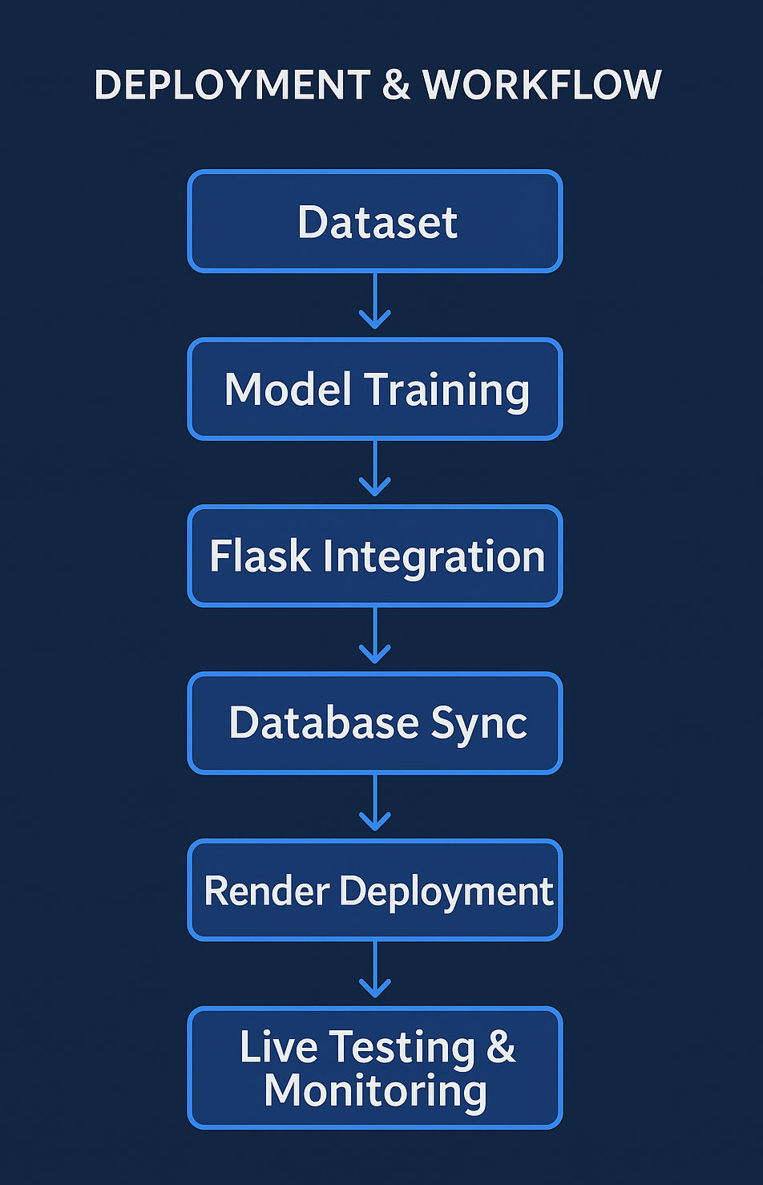
Deployment & Workflow
Deployment Platform: Render Cloud
System Hosting:
• Flask backend hosted on Render
• PostgreSQL cloud database
• Fully live and accessible
Version Control:
• GitHub used for repository management
• Model, backend, and frontend maintained separately
Deployment Workflow:
Dataset → Model Training → Flask Integration → Database Sync → Render Deployment → Live Testing

Slide 11
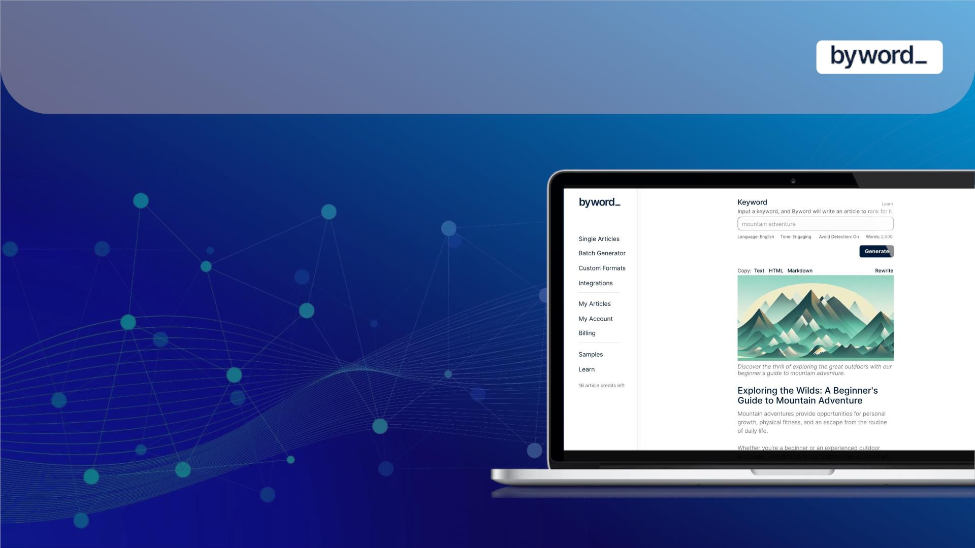
Conclusion
This project delivers an efficient AI-driven inventory forecasting system that accurately predicts sales and supports real-time stock monitoring across multiple stores. By integrating XGBoost modeling with a Flask backend, PostgreSQL database, and cloud deployment, the system ensures reliable performance and seamless data flow. The dashboard provides clear, actionable insights that help improve inventory decisions and reduce stockouts, demonstrating the practical value of machine learning in retail operations.

Slide 12
THANK YOU
Deployed Application:
🔗 https://smartstock-retail-optimizer.onrender.com

